Slide 1
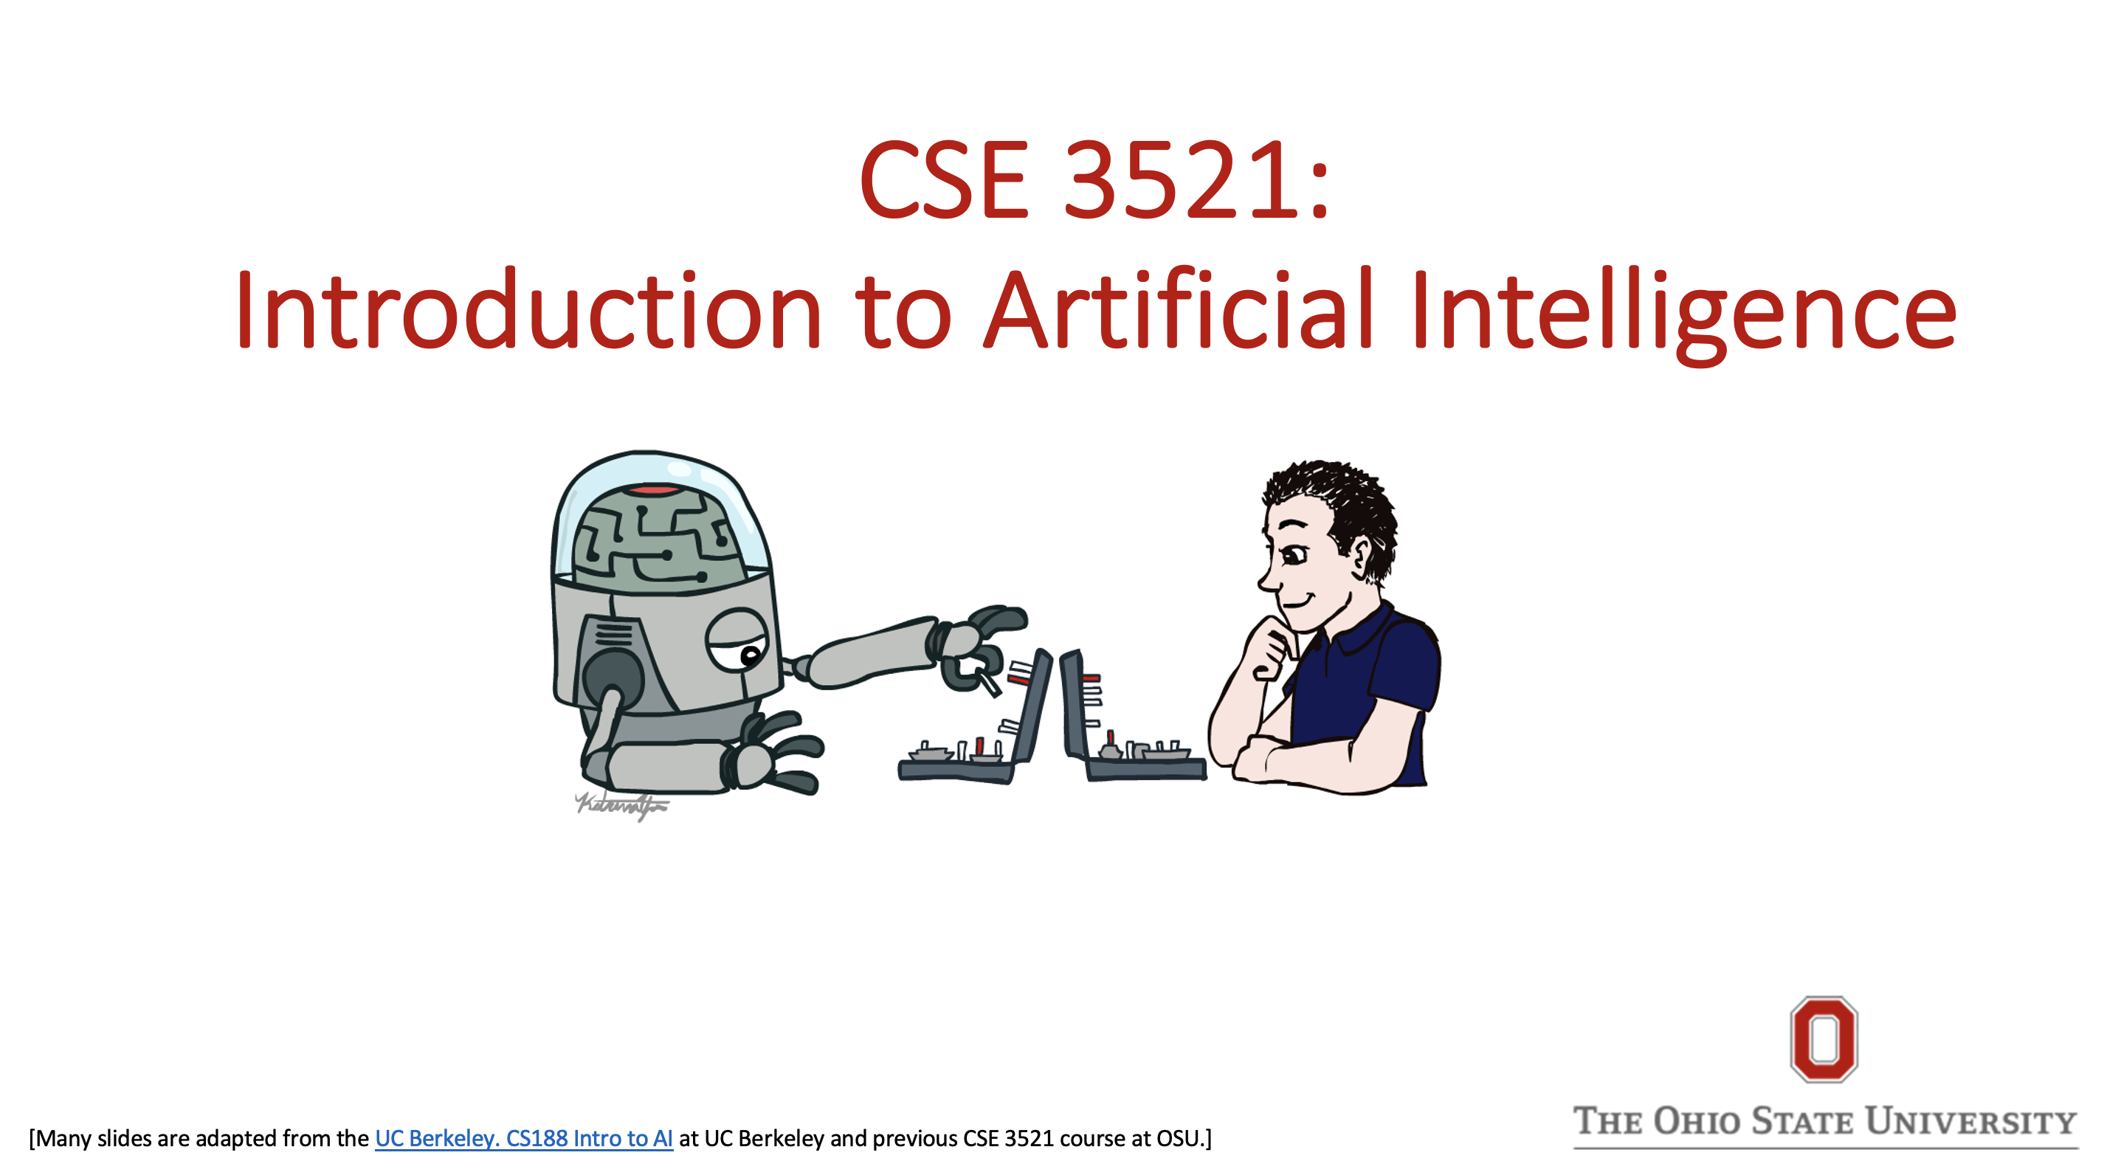

Slide 2
Logistic Regression

Slide 3
Naïve Bayes Recap
Bag of words (order independent)
Features are assumed independent given class
Q: Is this always true?

Slide 4
The problem with assuming conditional independence
Correlated features -> double counting evidence
Parameters are estimated independently
This can hurt classifier accuracy and calibration

Slide 5
Logistic Regression
(Log) Linear Model – similar to Naïve Bayes
Doesn’t assume features are independent
Correlated features don’t “double count”

Slide 6
What are “Features”?
A feature function, f
Input: Document, D (a string)
Output: Feature Vector, X

Slide 7
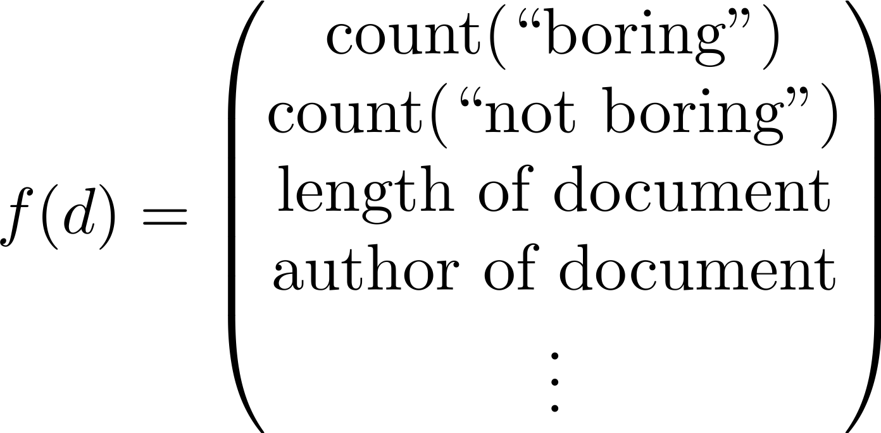
What are “Features”?
Doesn’t have to be just “bag of words”

Slide 8
Feature Templates
Typically “feature templates” are used to generate many features at once
For each word:
${w}_count
${w}_lowercase
${w}_with_NOT_before_count

Slide 9
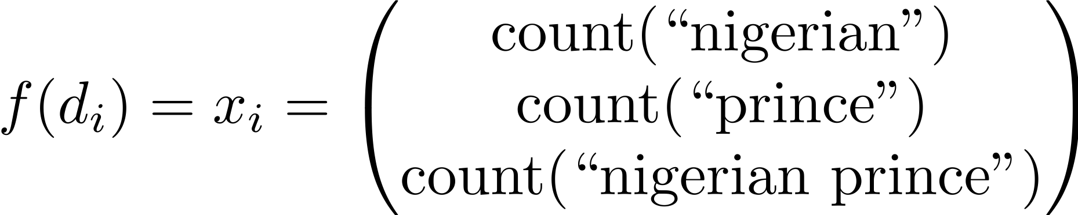
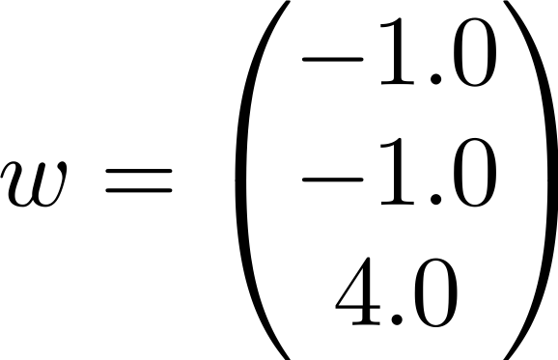
Logistic Regression: Example
Compute Features:
(“won”)
(“choose”)
(“$1,00,00,00,000”)
Assume we are given some weights:

Slide 10
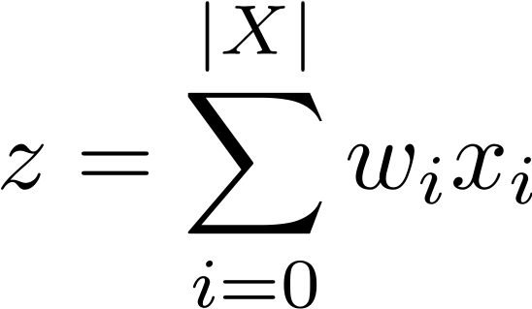
Logistic Regression: Example
Compute Features
We are given some weights
Compute the dot product:

Slide 11
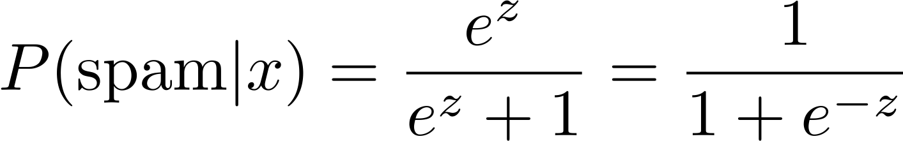
Logistic Regression: Example
Compute the dot product:
Compute the logistic function:
Notes:
Thanks for your detailed feedback. Below we added the answers for your concerns:

Slide 12
The Logistic function

Slide 13
The Dot Product
Intuition: weighted sum of features
All Linear models have this form

Slide 14
Naïve Bayes as a log-linear model
Q: what are the features?
Q: what are the weights?

Slide 15
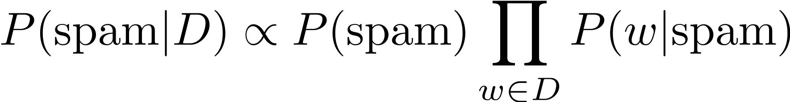
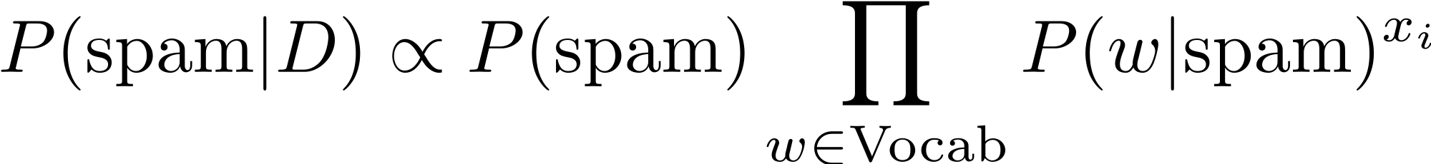
Naïve Bayes as a Log-Linear Model

Slide 16
Naïve Bayes as a Log-Linear Model
In both Naïve Bayes and Logistic Regression we Compute The Dot Product!

Slide 17
NB vs. LR
Both compute the dot product
NB: sum of log probabilities
LR: logistic function

Slide 18
NB vs. LR: Parameter Learning
Naïve Bayes:
Learn conditional probabilities independently by counting
Logistic Regression:
Learn weights jointly

Slide 19
LR: Learning Weights
Given: a set of feature vectors and labels
Goal: learn the weights

Slide 20
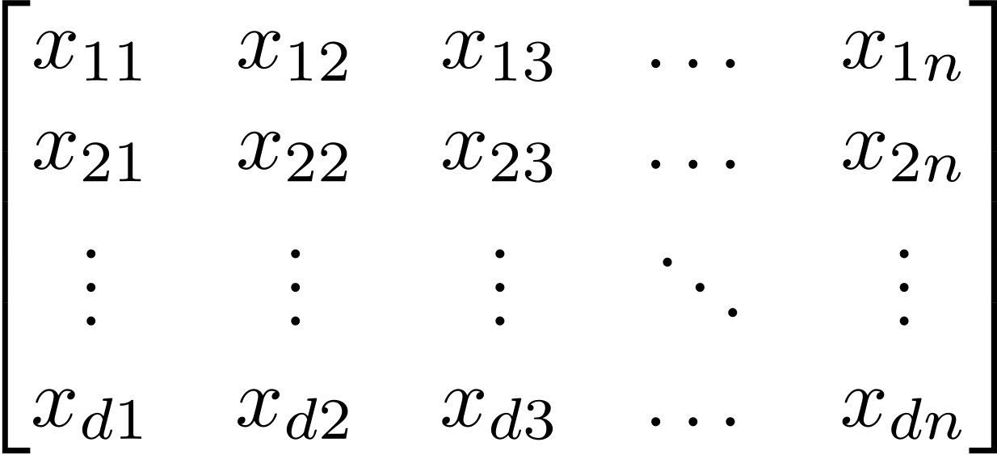
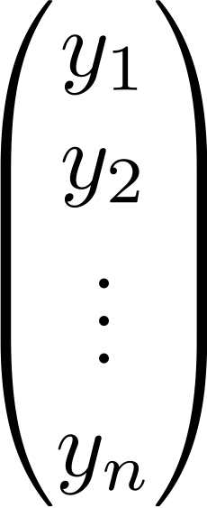
Learning Weights
Feature
Labels
Document

Slide 21
Q: what parameters should we choose?
What is the right value for the weights?
Maximum Likelihood Principle:
Pick the parameters that maximize the probability of the data

Slide 22
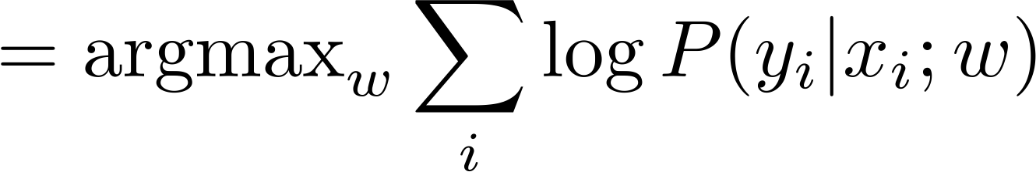
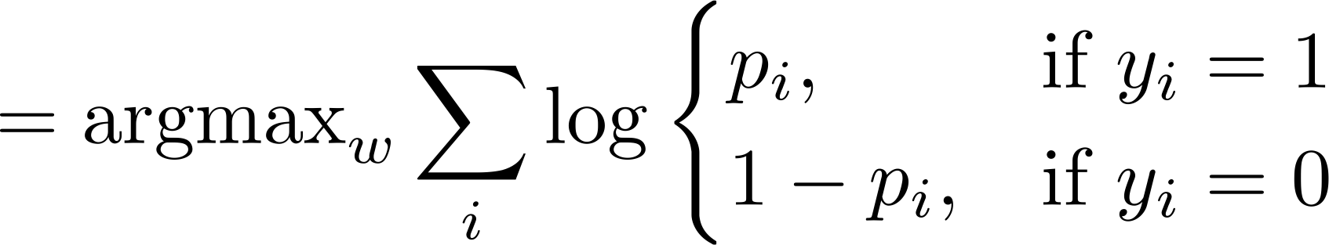
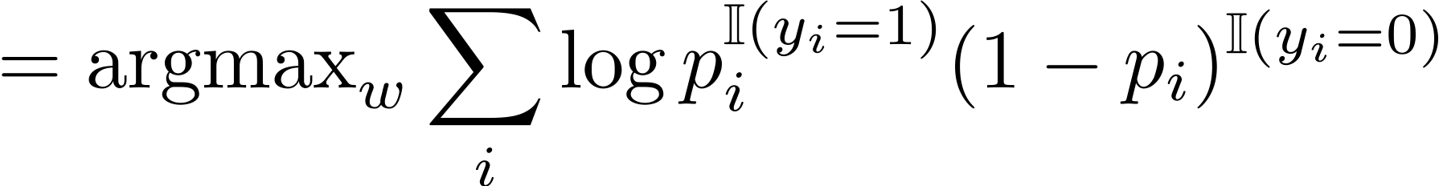
Maximum Likelihood Estimation

Slide 23
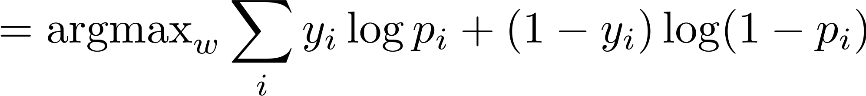
Maximum Likelihood Estimation

Slide 24
Maximum Likelihood Estimation
Unfortunately there is no closed form solution
(like there was with naïve bayes)
Solution:
Iteratively climb the log-likelihood surface through the derivatives for each weight
Luckily, the derivatives turn out to be nice

Slide 25
Logistic Regression: Pros and Cons
Doesn’t assume conditional independence of features
Better calibrated probabilities
Can handle highly correlated overlapping features
NB is faster to train, less likely to overfit

Slide 26
NB vs. LR
Both compute the dot product
NB: sum of log probabilities
LR: sum of weighted features

Slide 27
NB & LR
Both are linear models
Training is different:
NB: weights are trained independently
LR: weights trained jointly

Slide 28
NB vs. LR: Parameter Learning
Naïve Bayes:
Learn conditional probabilities independently by counting
Logistic Regression:
Learn weights jointly

Slide 29
Logistic Regression
(Log) Linear Model – similar to Naïve Bayes
Doesn’t assume features are independent
Correlated features don’t “double count”

Slide 30
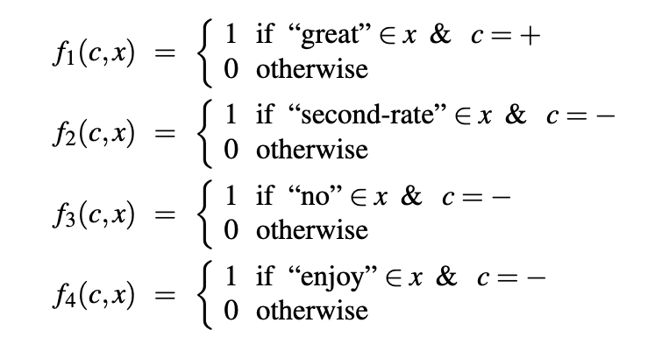
Features for movie review

Slide 31
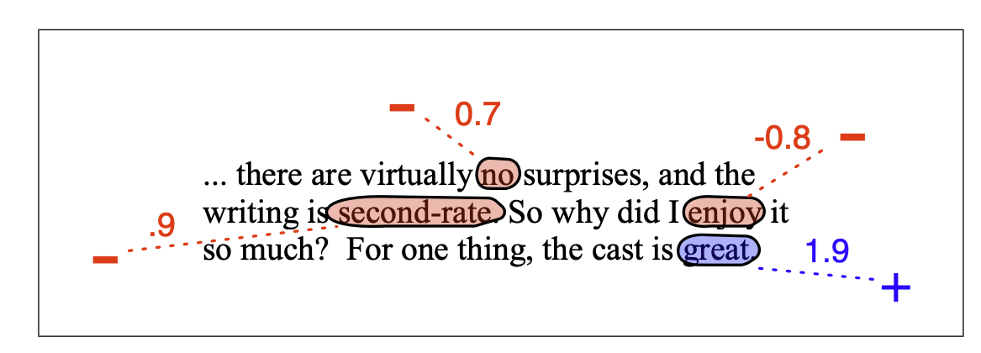
Features for movie review

Slide 32
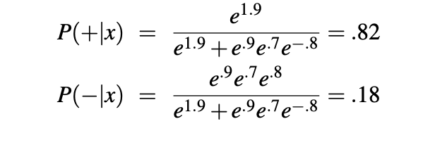
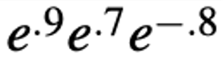
Features for movie review

Slide 33
Q: what parameters should we choose?
What is the right value for the weights?
Maximum Likelihood Principle:
Pick the parameters that maximize the probability of the data

Slide 34
Maximum Likelihood Estimation
Unfortunately there is no closed form solution
(like there was with naïve bayes)
Solution:
Iteratively climb the log-likelihood surface through the derivatives for each weight
Luckily, the derivatives turn out to be nice

Slide 35
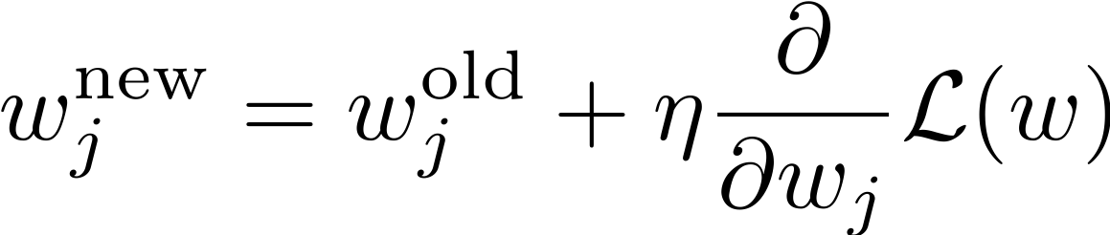
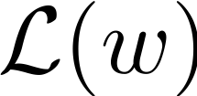
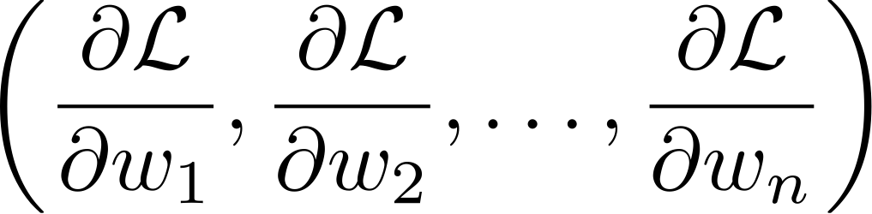
Gradient ascent
Loop While not converged:
For all features j, compute and add derivatives
: Training set log-likelihood
: Gradient vector

Slide 36
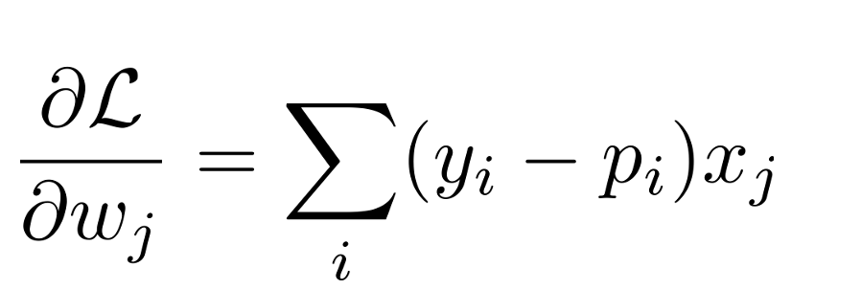
Gradient ascent
Loop While not converged:
For all features j, compute and add derivatives
: Training set log-likelihood
: Gradient vector

Slide 37
Gradient ascent
Loop While not converged:
For all features j, compute and add derivatives

Slide 38
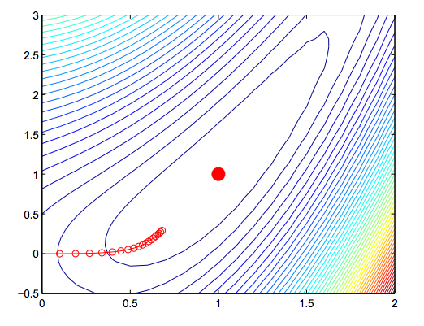


Gradient ascent

Slide 39
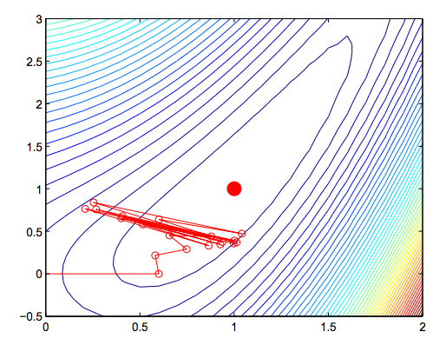
Gradient ascent

Slide 40
Derivative of Sigmoid

Slide 41
Learning Weights
Feature
Labels
Document

Slide 42
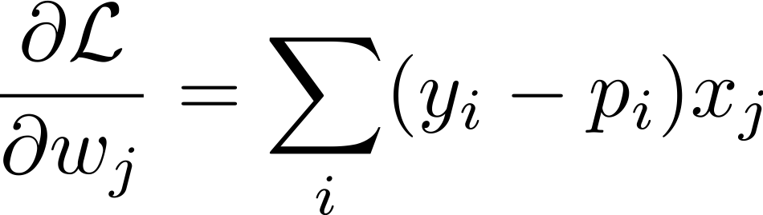
LR Gradient
j -> iterating over features
i -> iterating over training examples
Y_{i} = Ture label
P_{i} = Predicted Label

Slide 43
Gradient ascent
Loop While not converged:
For all features j, compute and add derivatives
: Training set log-likelihood
: Gradient vector

Slide 44
Perceptron Algorithm
Algorithm is Very similar to logistic regression
Not exactly computing gradients

Slide 45
Perceptron Algorithm
Algorithm is Very similar to logistic regression
Not exactly computing gradients
Initialize weight vector w = 0
Loop for K iterations
Loop For all training examples x_{i}
y_{i}’ = sign(w * x_{i})
if y_{i}’!= y_{i}
w += (y_{i} - y_{i}’) * x_{i}

Slide 46
Perceptron Notes
Guaranteed to converge if the data is linearly separable
Only hyperparameter is maximum number of iterations
Parameter averaging

Slide 47
Differences: LR vs. Perceptron
Batch Learning vs. Online learning
Perceptron doesn’t always make updates

Slide 48
Online Learning (perceptron)
Rather than making a full pass through the data, compute gradient and update parameters after each training example.
Gradients will be less accurate, but the overall effect is to move in the right direction
Often works well and converges faster than batch learning

Slide 49
MultiClass Classification
Q: what if we have more than 2 categories?
Sentiment: Positive, Negative, Neutral
Document topics: Sports, Politics, Business, Entertainment, …
Could train a separate logistic regression model for each category...
Pretty clear what to do with Naive Bayes.

Slide 50
MultiClass Classification
Q: what if we have more than 2 categories?
Sentiment: Positive, Negative, Neutral
Document topics: Sports, Politics, Business, Entertainment, …
Could train a separate logistic regression model for each category...
Pretty clear what to do with Naive Bayes.

Slide 51
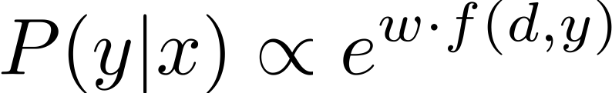
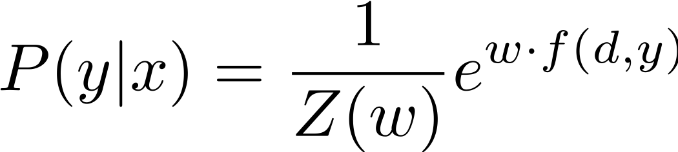
Log-Linear Models

Slide 52
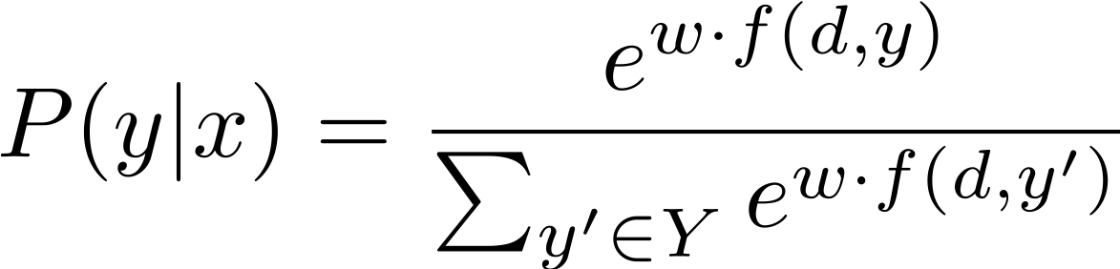
MultiClass Logistic Regression

Slide 53



MultiClass Logistic Regression
Binary logistic regression:
We have one feature vector that matches the size of the vocabulary
Multiclass in practice:
one weight vector for each category

Slide 54
MultiClass Logistic Regression
Binary logistic regression:
We have one feature vector that matches the size of the vocabulary
Multiclass in practice:
one weight vector for each category
Can represent this in practice with one giant weight vector and repeated features for each category.

Slide 55
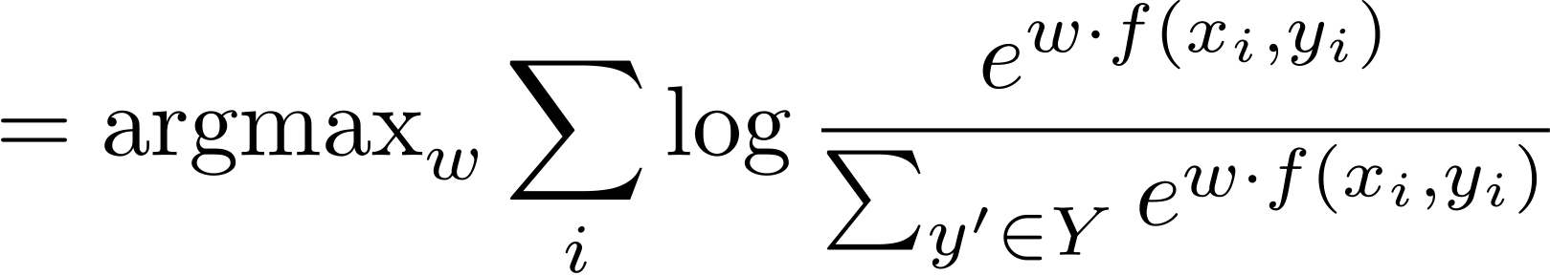
Maximum Likelihood Estimation

Slide 56
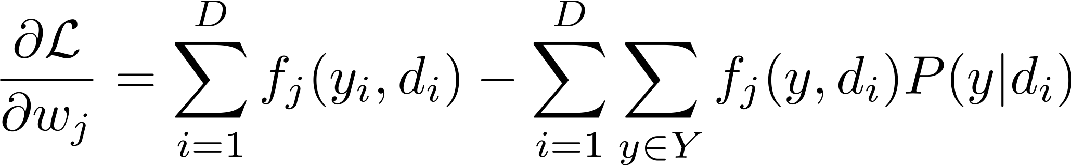
Multiclass Leaning
LR :

Slide 57
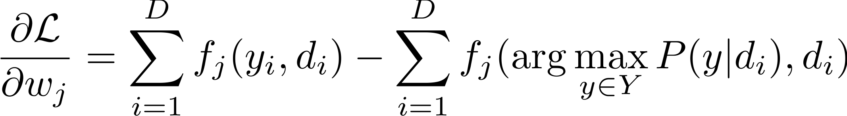
Multiclass Leaning
LR :
Perceptron :

Slide 58
Multiclass Leaning
LR :
Perceptron :

Slide 59
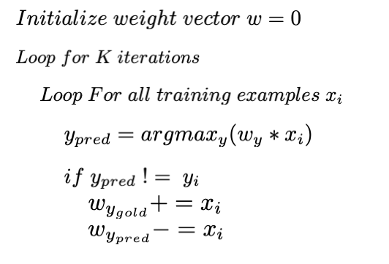
MultiClass Perceptron Algorithm

Slide 60
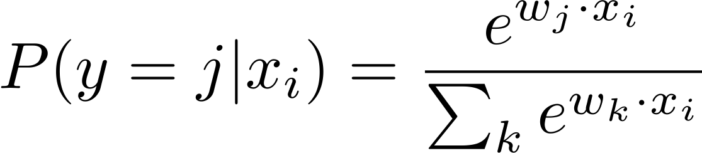
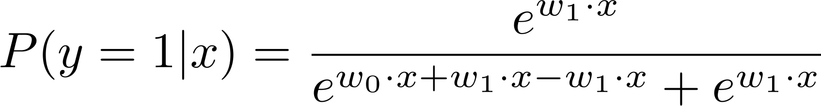
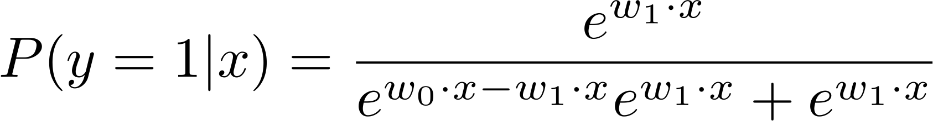
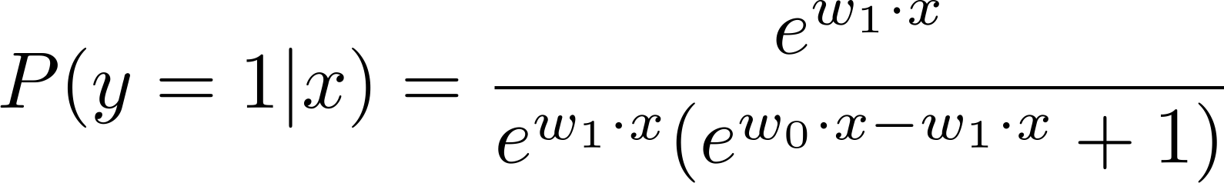
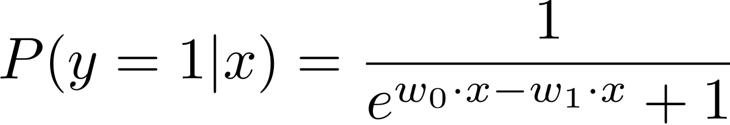
Q: what if there are only 2 categories?

Slide 61
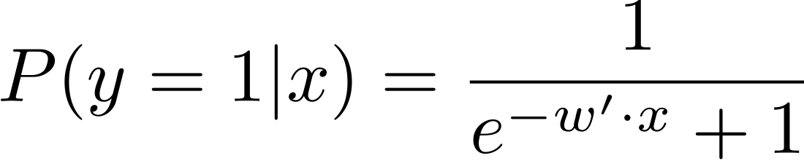

Q: what if there are only 2 categories?
Sigmoid (logistic) function

Slide 62
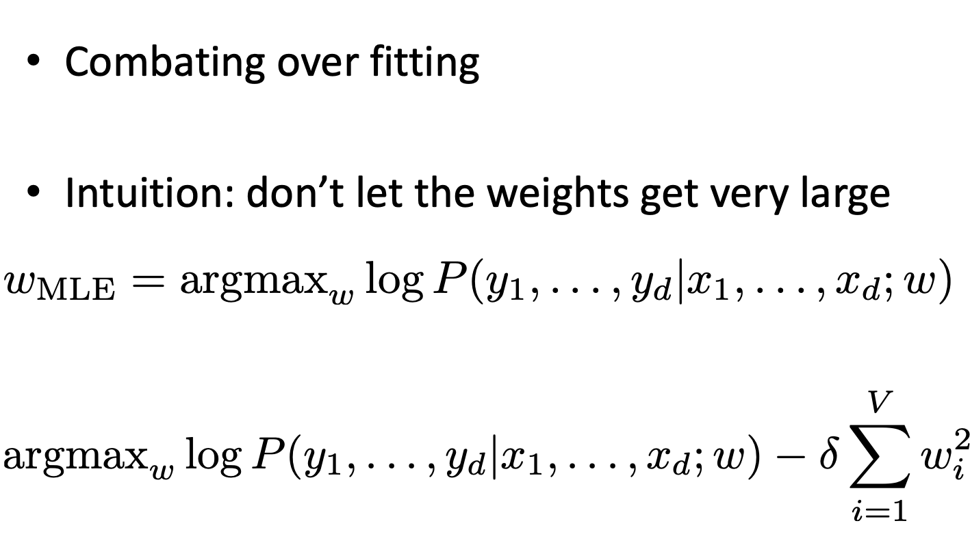
Regularization

